Slide 1
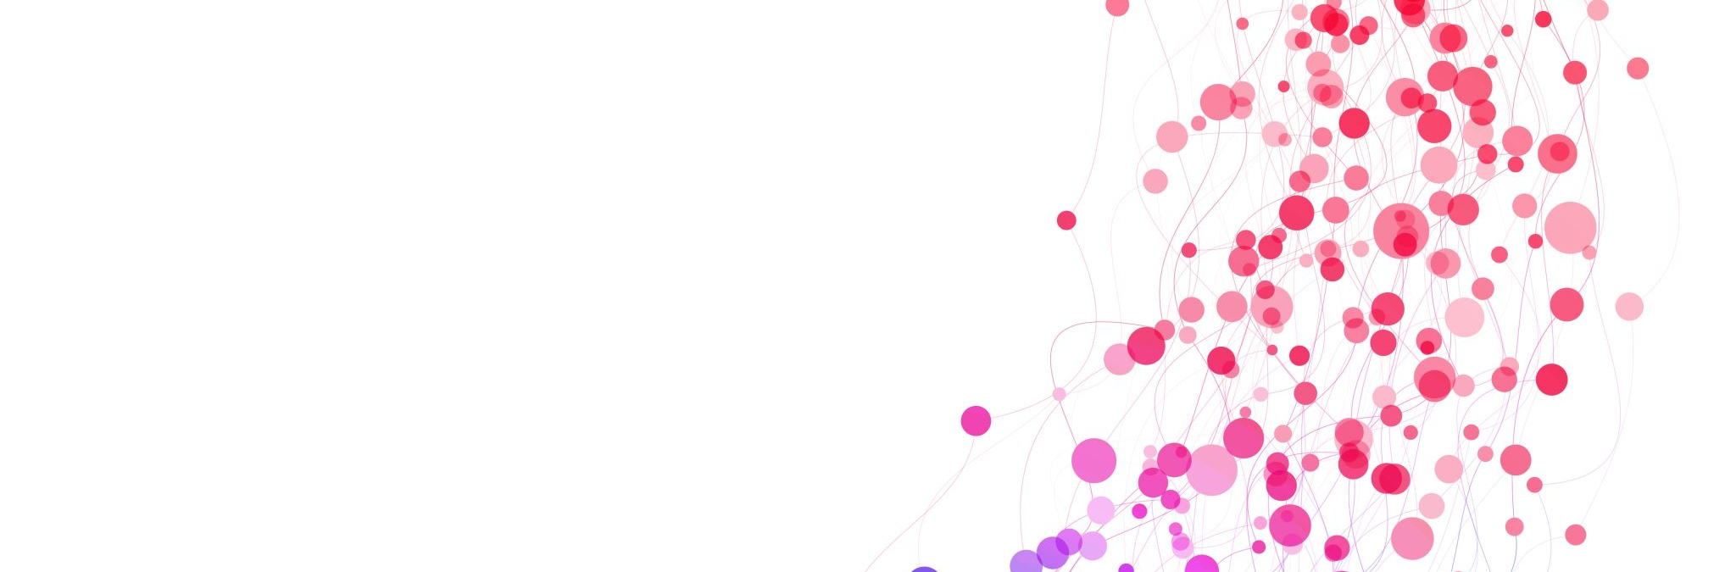
Portfolio second review
Cretu Claudia
Sem 2 Class 2

Slide 2
Interactive media products
Bad UX examples
Target audience & personas for the Branding project
Survey, survey summary & user testing for Media Campaign project

Slide 3
Development and version control
Responsiveness
Learning JavaScript
JavaScript Pdf buttons
JavaScript Tic tac toe exercise

Slide 4
Iterative design
Brand guide colors for Branding project
Facebook mockup for client from Branding project
Wireframe and prototype for Branding project
The pictures in my portfolio
Portfolio design
Posters ideas for Media campaign project

Slide 5
Personal leadership
Organized person
Feedback & reflection

Slide 6
Professional standard
Presentations
Project plan for Media Campaign project
Research for Media campaign project
Client contact person for Media campaign project

